Slide 1
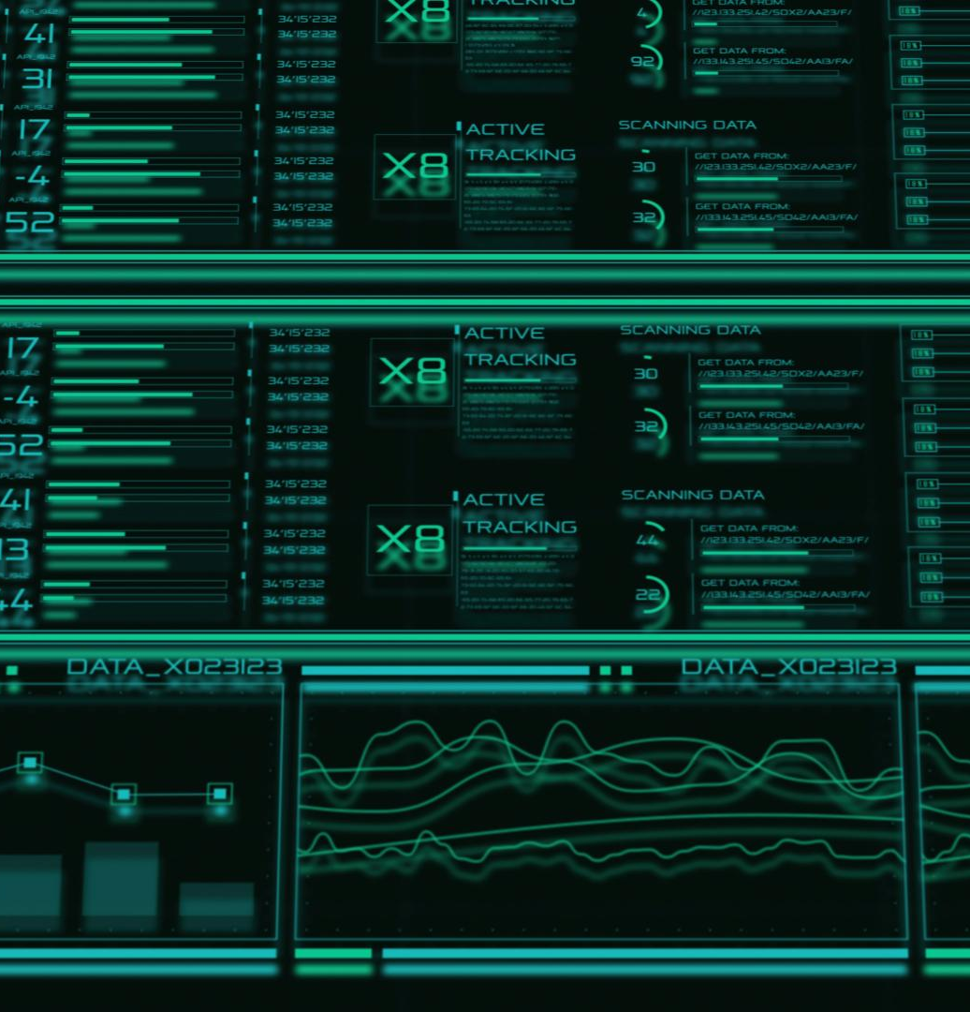
Hospital Patient Data Overview Dashboard
Comprehensive insights into patient health metrics
Notes:
AI-generated content may be incorrect. ---

Slide 2
Project Overview and Context
Notes:
Hospital Patient Data Overview Dashboard – Project Title and Scope, Introduction to the Python-Based Healthcare Dashboard

Slide 3
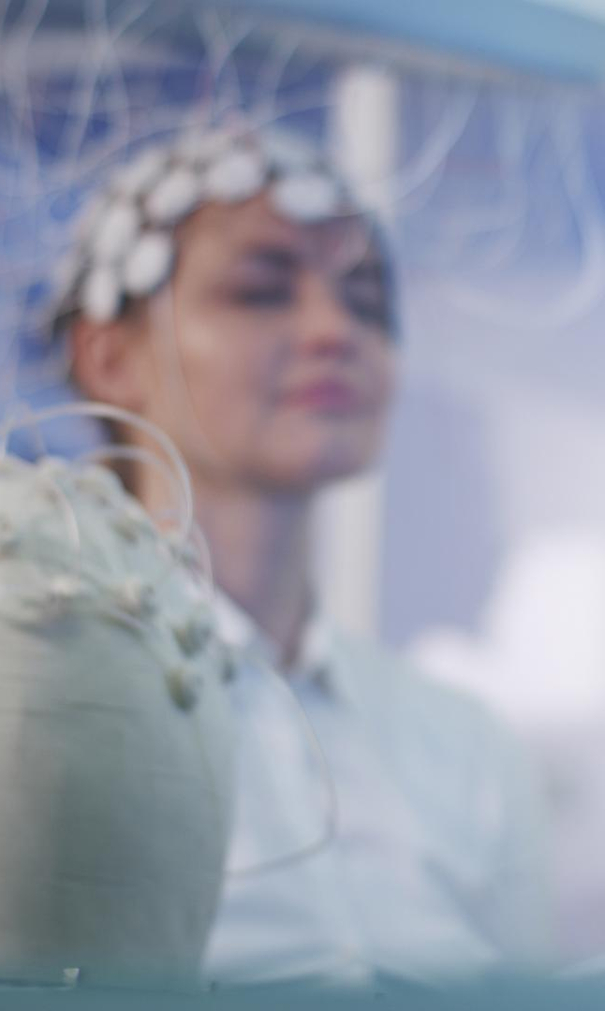
Hospital Patient Data Overview Dashboard – Project Title and Scope
Project Overview
A Python desktop app analyzes and visualizes hospital patient records for actionable insights.
Technology Stack
Uses Python, Tkinter, Pandas, and Matplotlib to process data and create an interactive GUI.
Data Focus
Patient data includes age, gender, disease type, treatment outcomes, and hospital billing info.
Project Importance
Automates hospital data reporting to provide timely insights, replacing manual methods.
Notes:
The Hospital Patient Data Overview Dashboard is a Python-based desktop application designed to analyze, summarize, and visualize hospital patient records in a structured and user-friendly manner. The primary scope of this project is to demonstrate how healthcare data can be transformed into actionable insights using a combination of data analysis libraries and graphical user interface technologies. Developed by Ahmed Masood, the system integrates Python with Tkinter for the interface, Pandas for data processing, and Matplotlib for visualization, forming a complete end-to-end analytical solution. The dashboard focuses on patient-centric data such as age, gender, disease type, treatment outcomes, and hospital billing, enabling healthcare staff or administrators to quickly interpret complex datasets. By consolidating raw CSV-based hospital records into an interactive dashboard, the project highlights the importance of automation in modern healthcare environments. Manual reporting methods often fail to provide timely insights, whereas a centralized dashboard allows instant access to statistics and visual summaries. This project also showcases Python’s versatility beyond scripting, illustrating its role in building real-world desktop applications. Additionally, the selected technology stack emphasizes accessibility, as all tools used are open-source and widely adopted in industry and academia. The dashboard is intended for educational and demonstrative purposes, but its architecture can be extended to real hospital systems with minimal changes. Overall, this slide establishes the project’s identity, technical foundation, and relevance to healthcare data analytics, setting the stage for a deeper discussion of the problem, objectives, system design, and outcomes in subsequent slides.

Slide 4
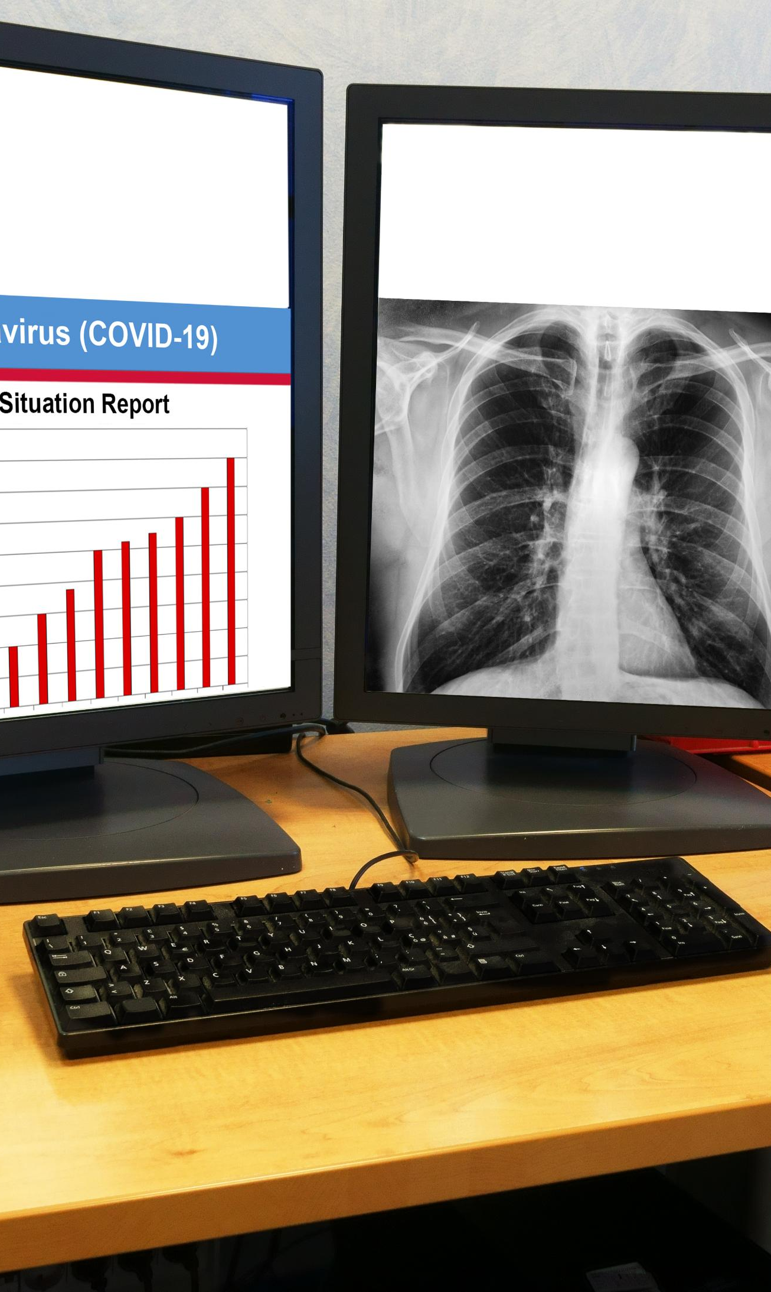
Introduction to the Python-Based Healthcare Dashboard
Purpose of Dashboard
The dashboard simplifies healthcare data analysis using automation and visualization for better decision-making.
User-Friendly Interface
Tkinter-based GUI provides an accessible interface for non-technical hospital staff to explore patient data easily.
Data Handling and Analysis
Pandas manages structured CSV data enabling filtering, grouping, and summarizing patient records efficiently.
Visual Data Storytelling
Matplotlib generates histograms, bar charts, and pie charts to visually represent patient demographics and metrics.
Notes:
The Hospital Patient Data Overview Dashboard is introduced as a desktop-based analytical system aimed at simplifying healthcare data analysis through automation and visualization. Built entirely in Python, the application provides an interactive graphical interface that allows users to load patient datasets, explore individual records, and review aggregated statistics without requiring advanced technical knowledge. The introduction emphasizes the growing need for data-driven decision-making in healthcare, where hospitals generate large volumes of patient data daily. Traditional spreadsheet-based analysis is often insufficient for identifying patterns or trends, especially when datasets grow in size and complexity. This dashboard addresses that gap by combining data preprocessing, statistical computation, and visual representation within a single application. Tkinter is used to design a professional and responsive GUI, ensuring usability for non-technical users such as hospital administrators or medical staff. Pandas plays a critical role in handling structured CSV data, enabling efficient filtering, grouping, and summarization of patient records. Matplotlib is integrated to convert numerical insights into intuitive charts such as histograms, bar charts, and pie charts. Through this combination, the system not only presents data but also tells a visual story about patient demographics, disease distribution, treatment effectiveness, and financial metrics. The introduction sets the foundation for understanding how the dashboard functions as a decision-support tool, highlighting its role in improving efficiency, reducing errors, and supporting informed healthcare planning.

Slide 5
Problem Definition and Project Goals
Notes:
Problem Statement: Challenges in Managing Hospital Patient Data, Project Objectives and Expected Outcomes

Slide 6

Problem Statement: Challenges in Managing Hospital Patient Data
Data Volume and Complexity
Hospitals generate large volumes of diverse patient data daily, making manual management inefficient and error-prone.
Lack of Centralized Tools
Absence of automated, centralized dashboards hinders meaningful analysis of patient trends and treatment outcomes.
Impact on Decision-Making
Without visual analytics, hospital staff face challenges in strategic planning, resource allocation, and quality assessment.
Automation and Visualization Solution
Proposed Python-based dashboard automates data processing and provides clear, interactive visualizations to improve reliability.
Notes:
Hospitals and healthcare institutions generate vast amounts of patient-related data on a daily basis, including demographic information, diagnoses, treatments, admission details, and billing records. Managing this information manually or through fragmented systems is highly inefficient and prone to human error. One of the key challenges highlighted in this problem statement is the lack of centralized and automated tools for analyzing patient data in a meaningful way. Without proper visualization and analytical support, hospital staff struggle to identify trends such as disease prevalence, patient age distributions, or treatment outcomes. This limitation directly affects strategic planning, resource allocation, and quality of care assessment. Additionally, manual data handling consumes valuable time that could otherwise be dedicated to patient care or operational improvements. Inconsistent data entry, missing values, and unstructured reporting further complicate analysis. The absence of visual dashboards makes it difficult for decision-makers to quickly grasp the current state of hospital performance. As healthcare systems continue to digitize, the need for efficient analytical dashboards becomes increasingly critical. This project addresses these challenges by proposing an automated, Python-based dashboard that processes raw patient data and presents it in a clear, visual, and interactive format, reducing dependency on manual methods and enhancing overall data reliability.

Slide 7

Project Objectives and Expected Outcomes
User-Friendly Data Exploration
The dashboard enables efficient analysis with intuitive navigation and summarized patient information views.
Statistical Computation with Pandas
Accurate calculations of key metrics like average age, hospital stay, and billing are performed using Pandas.
Visualization Using Matplotlib
Graphical charts generated with Matplotlib improve interpretability of patient statistics and trends.
Healthcare Decision Support
The dashboard supports healthcare decision-making by quickly revealing key trends and performance indicators.
Notes:
The primary objective of the Hospital Patient Data Overview Dashboard is to design and implement a user-friendly application that enables efficient analysis of hospital patient records. One key goal is to simplify data exploration by providing intuitive navigation, search functionality, and summarized views of patient information. Another objective is to leverage Pandas for accurate and efficient computation of statistics such as average age, average hospital stay, and billing metrics. Visualizing these statistics through Matplotlib charts is a central outcome, as graphical representations significantly improve interpretability. The project also aims to demonstrate practical Python skills, particularly in GUI development using Tkinter and data analysis workflows commonly used in real-world applications. From a healthcare perspective, the expected outcome is improved decision-making support, where administrators can quickly assess trends and performance indicators. Educationally, the project serves as a comprehensive example of integrating multiple Python libraries into a cohesive system. By the end of the project, the dashboard successfully meets its objectives by providing clear insights, reducing manual workload, and showcasing how technology can enhance healthcare data management.

Slide 8
Technology Stack and Data Foundation
Notes:
Tools and Technologies Used in the Dashboard, Dataset Description and Preprocessing Approach

Slide 9

Tools and Technologies Used in the Dashboard
Core Programming Language
Python is used for its readability, extensive libraries, and strong support in data analysis and processing.
User Interface Framework
Tkinter provides a simple, dependency-free GUI framework for desktop application interfaces.
Data Manipulation Tools
Pandas is employed for efficient CSV data handling, missing value management, and statistical computation.
Data Visualization
Matplotlib creates customizable charts that clearly communicate analysis results.
Notes:
The Hospital Patient Data Overview Dashboard is built using a carefully selected technology stack that balances simplicity, power, and accessibility. Python serves as the core programming language due to its readability, extensive library ecosystem, and strong support for data analysis. Tkinter is chosen as the GUI framework, allowing the creation of a desktop interface without relying on external dependencies. For data manipulation and preprocessing, Pandas is used extensively, enabling efficient handling of CSV datasets, missing value management, and statistical calculations. Matplotlib is integrated for data visualization, providing a wide range of customizable charts that effectively communicate analytical results. Visual Studio Code is utilized as the development environment, offering debugging tools, extensions, and version control support that streamline the development process. The data source for the application is a CSV file containing structured hospital patient records, which makes the system easy to test and extend. Together, these technologies form a robust yet lightweight solution suitable for both academic projects and small-scale healthcare applications.

Slide 10

Dataset Description and Preprocessing Approach
Dataset Overview
The dataset includes detailed hospital patient records with demographics, treatment, and billing information in CSV format.
Data Preprocessing Steps
Preprocessing involves handling missing values, fixing inconsistencies, and converting date fields for reliable analysis.
Derived Metrics Calculation
Accurate preprocessing enables calculation of metrics like length of stay and average billing for meaningful insights.
Importance of Data Quality
Data preparation ensures dashboard visualizations are reliable, forming the backbone of analytical accuracy.
Notes:
The dataset used in the dashboard consists of hospital patient records stored in a CSV format, making it easy to load and process using Pandas. Key attributes include patient ID, age, gender, disease, admission type, admission and discharge dates, length of stay, treatment details, outcomes, and hospital billing information. Before visualization, the dataset undergoes preprocessing to ensure data quality and consistency. This includes handling missing values, correcting inconsistent entries, and converting date fields into usable formats. Calculating derived metrics such as length of stay or average billing requires accurate preprocessing steps. By cleaning and structuring the data beforehand, the dashboard ensures that all visualizations and statistics are reliable. This slide emphasizes the importance of data preparation in analytics projects, as even the most advanced visualization tools cannot compensate for poor data quality. The preprocessing stage forms the backbone of the system’s analytical accuracy.

Slide 11
System Design and Functional Features
Notes:
System Workflow and Data Processing Pipeline, Dashboard Features and User Interaction

Slide 12

System Workflow and Data Processing Pipeline
Data Loading and Reading
Hospital datasets are loaded from CSV files and read into the system using data handling libraries like Pandas.
Data Preprocessing
Data undergoes cleaning, formatting, and validation to ensure accuracy and consistency for analysis.
Statistical Calculations
Key metrics like patient counts, averages, and data distributions are calculated from the preprocessed data.
Visualization and Dashboard Display
Processed data is visualized through charts and displayed in tables and summary panels within the dashboard GUI.
Notes:
The system workflow of the Hospital Patient Data Overview Dashboard follows a clear and logical sequence designed to transform raw data into meaningful insights. The process begins with loading the hospital dataset from a CSV file, which is then read into the application using Pandas. Once loaded, the data undergoes preprocessing steps such as cleaning, formatting, and validation. Statistical calculations are then performed to derive key metrics, including patient counts, averages, and distributions. The processed data is displayed within the GUI through tables and summary panels, allowing users to inspect individual records. Visualization functions are triggered to generate charts that represent demographic and clinical trends. Finally, these insights are presented cohesively within the dashboard interface. This structured workflow ensures accuracy, efficiency, and repeatability, making the system reliable for regular use.

Slide 13
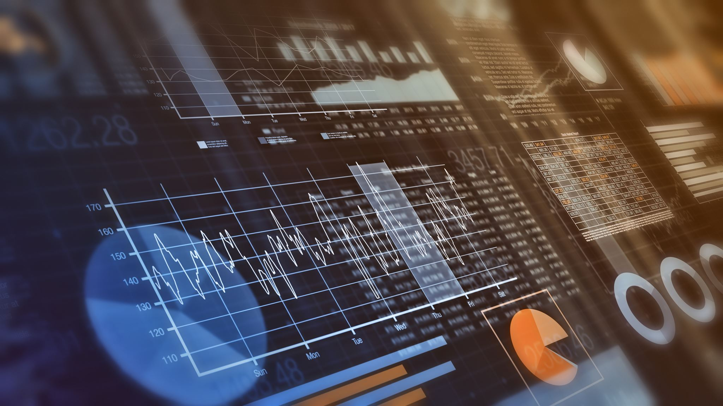
Dashboard Features and User Interaction
User-Friendly Interface
The dashboard has a professional GUI layout that ensures clarity and easy navigation for users.
Patient Data Access
Users can view patient summaries, search by patient ID, and scroll through detailed record tables.
Analytical Features
Includes analyses of age, gender, disease distribution, treatment outcomes, and hospital bill evaluations.
Interactive Functionality
Features like exporting summaries and refreshing data create a dynamic, interactive user experience.
Notes:
The dashboard offers a comprehensive set of features designed to enhance usability and analytical depth. A professional GUI layout ensures clarity and ease of navigation. Users can view patient summaries, search records by patient ID, and scroll through detailed tables of records. Analytical features include age, gender, and disease distribution analyses, as well as treatment outcome and hospital bill evaluations. A dedicated statistics panel presents key numerical insights at a glance. Additional functions such as exporting summaries and refreshing the dashboard improve practicality. These features collectively create an interactive environment where users can explore data dynamically rather than passively viewing static reports.

Slide 14
Visualization, Results, and Future Outlook
Notes:
Data Visualizations and Analytical Results, Challenges, Future Enhancements, and Conclusion

Slide 15
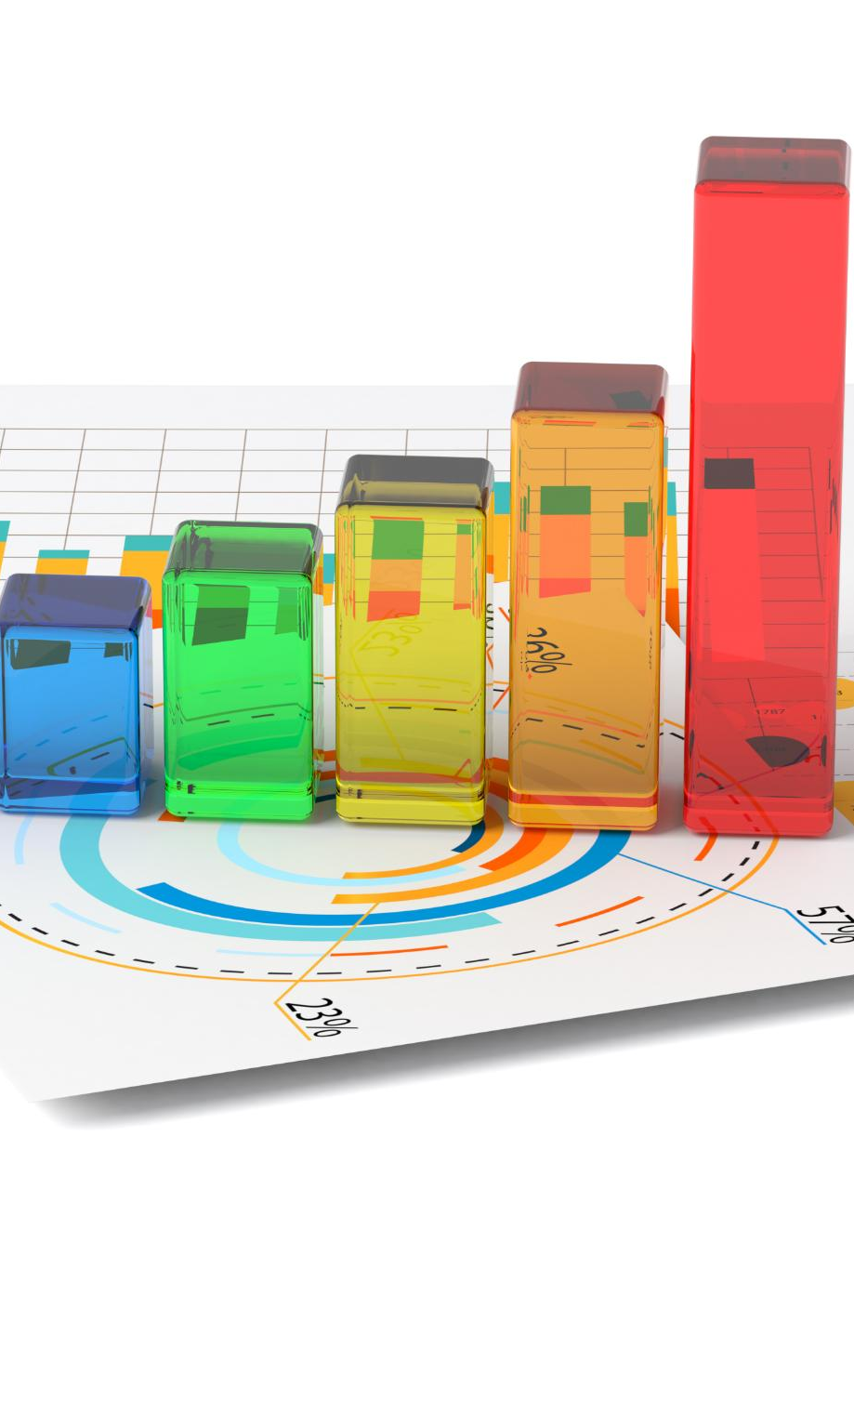
Data Visualizations and Analytical Results
Data Visualization Types
The dashboard uses histograms, bar charts, and pie charts to represent patient data visually.
Identifying Trends
Visualizations enable quick identification of trends like disease prevalence, gender ratios, and cost patterns.
Analytical Results
The system calculates total patient counts, average age, length of stay, and hospital bills for analysis.
Healthcare Decision Support
Combining visuals with data summaries enhances accessibility and supports informed healthcare decisions.
Notes:
Data visualization is a core strength of the Hospital Patient Data Overview Dashboard, transforming numerical data into intuitive graphical representations. The dashboard includes histograms for age and hospital bill distributions, bar charts for gender and disease frequencies, and pie charts for treatment outcomes. These visualizations allow users to quickly identify trends such as dominant diseases, gender ratios, or cost patterns. The results generated by the system include total patient counts, average age, average length of stay, and average hospital bills. By combining numerical summaries with visual charts, the dashboard enhances data accessibility and supports informed healthcare decision-making. The analytical results demonstrate the effectiveness of integrating Python-based visualization tools into healthcare analytics.

Slide 16

Challenges, Future Enhancements, and Conclusion
Development Challenges
Key challenges included dataset management, data inconsistencies, GUI design, and chart integration within the application.
Future Enhancements
Planned improvements include database integration, user authentication, real-time monitoring, and cloud deployment.
Advanced Features
Incorporating machine learning for disease prediction and web-based dashboards will expand system capabilities.
Project Conclusion
The dashboard showcases Python’s practical use in healthcare analytics, supporting better data analysis and decisions.
Notes:
During development, several challenges were encountered, including managing dataset file paths, handling missing or inconsistent data, designing an intuitive interface, and integrating charts within the GUI. Despite these challenges, the project successfully achieved its objectives. Looking ahead, the system can be enhanced through database integration, user authentication, real-time monitoring, and cloud deployment. Advanced features such as machine learning-based disease prediction and web-based dashboards could further expand its capabilities. In conclusion, the Hospital Patient Data Overview Dashboard demonstrates the practical application of Python in healthcare analytics. By integrating Tkinter, Pandas, and Matplotlib, the project delivers an efficient, interactive, and insightful platform that improves data analysis and supports better healthcare decisions. The final slide concludes with appreciation and invites questions, reinforcing the project’s educational and practical value.

